Slide 1
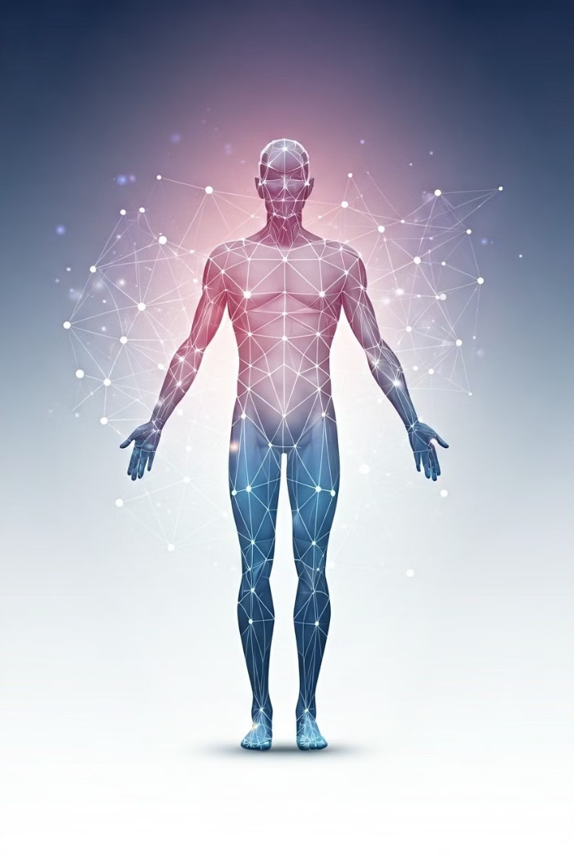
Human Activity Recognition: A Comprehensive Introduction
Human activity recognition (HAR) is the process of identifying and understanding human actions and behaviors using sensor data.
A.Dhanush(192210588)
B.Prudhvi(192210619)

Slide 2
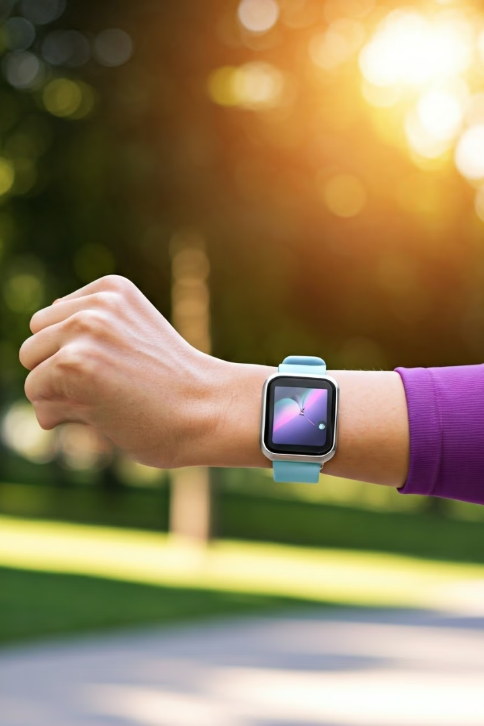
Importance of Human Activity Recognition
HAR plays a crucial role in various applications, including healthcare, fitness, smart homes, and security.
Personalized Healthcare
Smart Homes
HAR can help monitor patient health, detect falls, and manage chronic conditions.
HAR enables home automation, such as adjusting lighting, temperature, and appliances based on user activity.
Fitness Tracking
Security & Surveillance
HAR is essential for wearable fitness devices that track steps, calories burned, and exercise routines.
HAR can be used in security systems to detect suspicious behavior or unauthorized access.

Slide 3
Challenges in Traditional Approaches
Traditional HAR approaches relied heavily on handcrafted features and predefined rules, making them inflexible and prone to errors.
Limited Adaptability
High Computational Cost
Poor Generalizability
Traditional methods struggled to adapt to diverse environments and individual variations.
Handcrafted features required extensive domain expertise and were computationally expensive to extract.
Models trained on one dataset often performed poorly when tested on different data, limiting their real-world applicability.

Slide 4

Machine Learning for Activity Recognition
Machine learning (ML) revolutionized HAR by automating feature extraction and allowing for more robust and adaptable models.
1
Automated Feature Extraction
2
Improved Generalizability
ML models can generalize well to unseen data, enabling them to adapt to different environments and individuals.
ML algorithms can automatically learn relevant features from sensor data without human intervention.
3
Reduced Computational Cost
4
Enhanced Accuracy
ML-based HAR systems have consistently achieved higher accuracy compared to traditional approaches.
ML algorithms often require less computational power than traditional methods, making them more efficient.

Slide 5
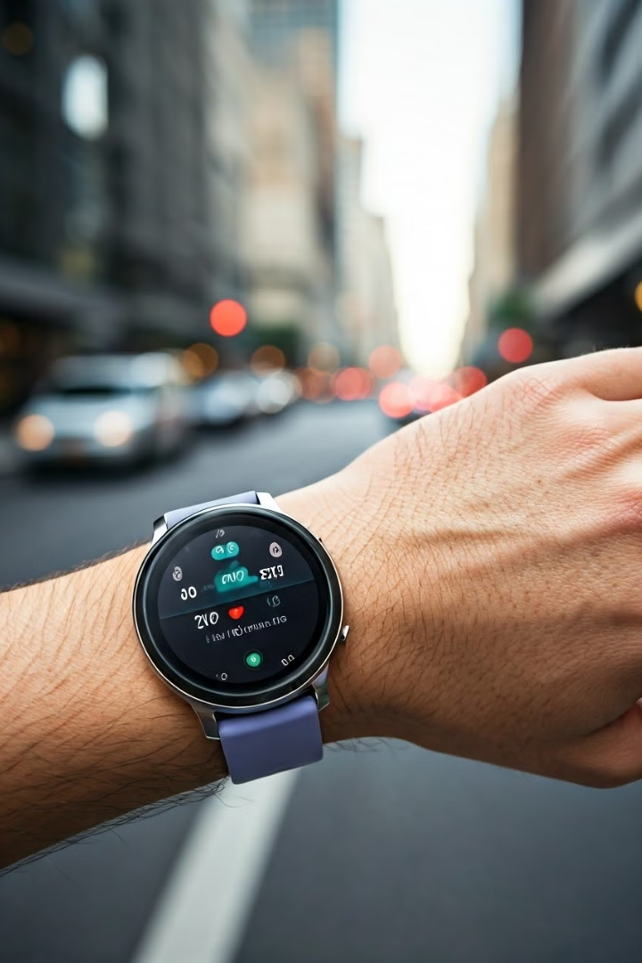
Sensor Data Acquisition and Preprocessing
The first step in HAR is acquiring sensor data from wearable devices or environmental sensors, followed by preprocessing to clean and prepare the data for analysis.
1
Data Acquisition
Sensors collect data about motion, location, and other physiological parameters, such as heart rate and skin temperature.
2
Data Cleaning
Noise and outliers are removed from the data to ensure accuracy and prevent biases in the model's learning process.
3
Data Normalization
Data is scaled to a common range, ensuring that all features contribute equally to the model's training and prediction.

Slide 6




Feature Engineering and Selection
Feature engineering involves transforming raw sensor data into meaningful features that capture the essence of human activities.
Feature Extraction
Feature Selection
Dimensionality Reduction
Raw sensor data is processed to extract relevant features, such as mean, variance, and frequency domain characteristics.
The most informative features are selected based on their relevance and importance for the task of activity recognition.
The number of features is reduced to avoid overfitting and improve model performance.

Slide 7

Machine Learning Algorithms for Activity Recognition
Various ML algorithms, such as supervised and unsupervised learning methods, can be employed for HAR, each with its strengths and limitations.
Algorithm
Description
Support Vector Machines (SVMs)
Effective for classifying activities based on complex and high-dimensional data.
Decision Trees
Easy to interpret and provide insights into the decision-making process.
Hidden Markov Models (HMMs)
Well-suited for recognizing activities with temporal dependencies.
Neural Networks
Powerful for handling complex patterns and learning from large datasets.

Slide 8
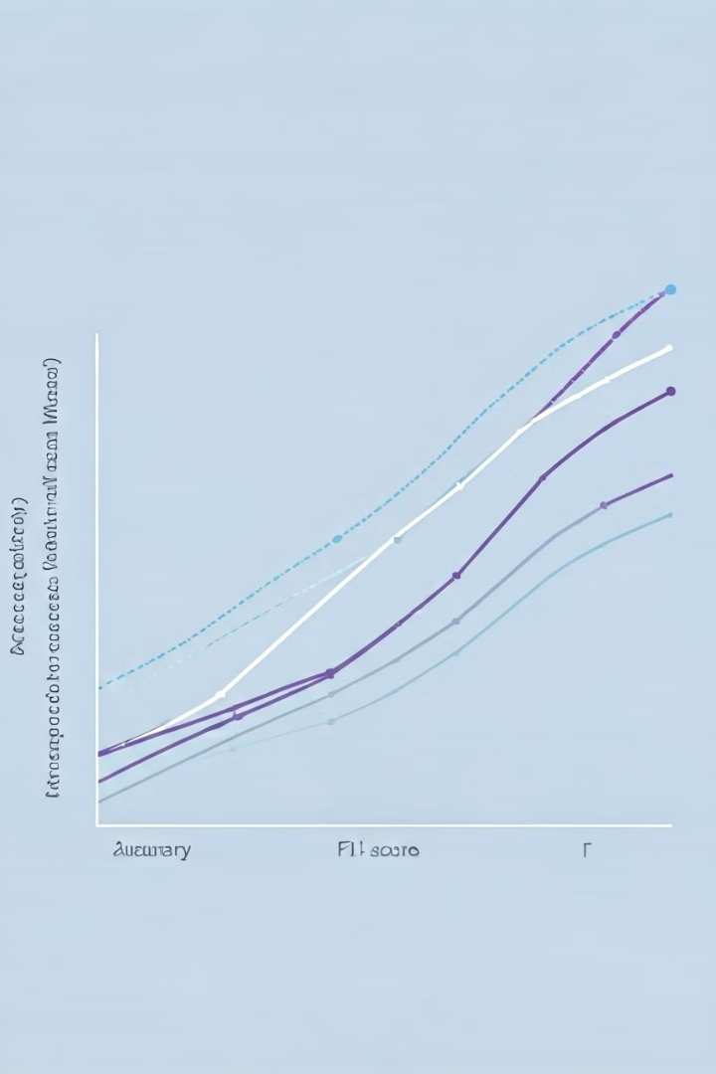




Evaluation Metrics and Benchmarking
Evaluating the performance of HAR systems is essential to ensure accuracy and reliability, using metrics such as accuracy, precision, recall, and F1-score.
Accuracy
Precision
The percentage of correctly classified activities.
The proportion of correctly identified instances of a specific activity out of all instances predicted as that activity.
Recall
F1-score
The proportion of correctly identified instances of a specific activity out of all actual instances of that activity.
A harmonic mean of precision and recall, providing a balanced measure of model performance.

Slide 9

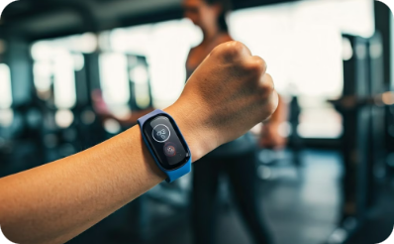


Practical Applications and Use Cases
HAR has numerous practical applications across diverse industries, addressing real-world problems and enhancing human well-being.
Healthcare
Fitness
Smart Homes
Security
Fall detection, activity monitoring, and rehabilitation.
Personalized training plans, activity tracking, and health insights.
Home automation, energy efficiency, and personalized comfort.
Intruder detection, anomaly detection, and surveillance.

Slide 10

Conclusion and Future Directions
HAR has made significant progress, driven by advancements in ML and sensor technology. Future directions include improving accuracy, robustness, and privacy considerations.
1
Improving Accuracy
2
Enhancing Robustness
Developing more sophisticated ML models and utilizing more diverse sensor data.
Addressing challenges related to noise, outliers, and variations in human behavior.
3
Privacy Considerations
Developing privacy-preserving techniques to protect sensitive user data and ensure ethical data collection.

